Slide 1
Data Visualization Assignment- 14 PowerPoint Presentation Using Project Data
By- Thushar Mohan
ID- 110559087

Slide 2
AGENDA
Introduction
Purpose of the study
Objective
Data Processing
Exploratory Data Analysis
Visualization
Summary
Conclusion
Sources and References

Slide 3
Introduction
The data we are going to be using is from Zomato Bangalore, it is a food delivery in India which is very similar to how Uber eats is in the United States. Due to the entrance of domestic and foreign enterprises, the restaurant industry in India has seen a spectacular transition, leading to a lack of trained specialists. Indian eateries have gone online to draw in more customers, and culinary schools have increased their offerings to keep up with demand. New restaurants can profit from researching the elements influencing their location, such as increasing disposable incomes, a growing young population, increased exposure to various cultures and cuisines, and an increase in people's propensity to eat out, as the market for the food services industry continues to expand.

Slide 4
Purpose of the study
The purpose of this study is to conduct a rigorous analysis of the Zomato dataset to identify the key variables that impact restaurant ratings and restaurant types in Bengaluru, India.
Given the high demand for restaurants in this city, it is imperative to thoroughly investigate the local demographics in order to identify the most popular cuisines and restaurant themes.
Through a comprehensive examination of factors such as pricing, location, and cuisine type, this study aims to gain a deep understanding of local food trends and demands.
By utilizing advanced data analysis techniques, this study aims to provide a technically sound and reliable assessment of the restaurant industry in Bengaluru.

Slide 5
Objective
The study aims to analyze the Zomato dataset of over 50,000 restaurants in Bengaluru, India.
The objective is to identify factors impacting the aggregate rating of each restaurant.
The study also examines local demographic trends affecting restaurant popularity.
Advanced data cleaning, scraping, and analysis techniques are utilized.
A final project notebook documents the results.
The study provides valuable insights into the restaurant industry in Bengaluru.

Slide 6
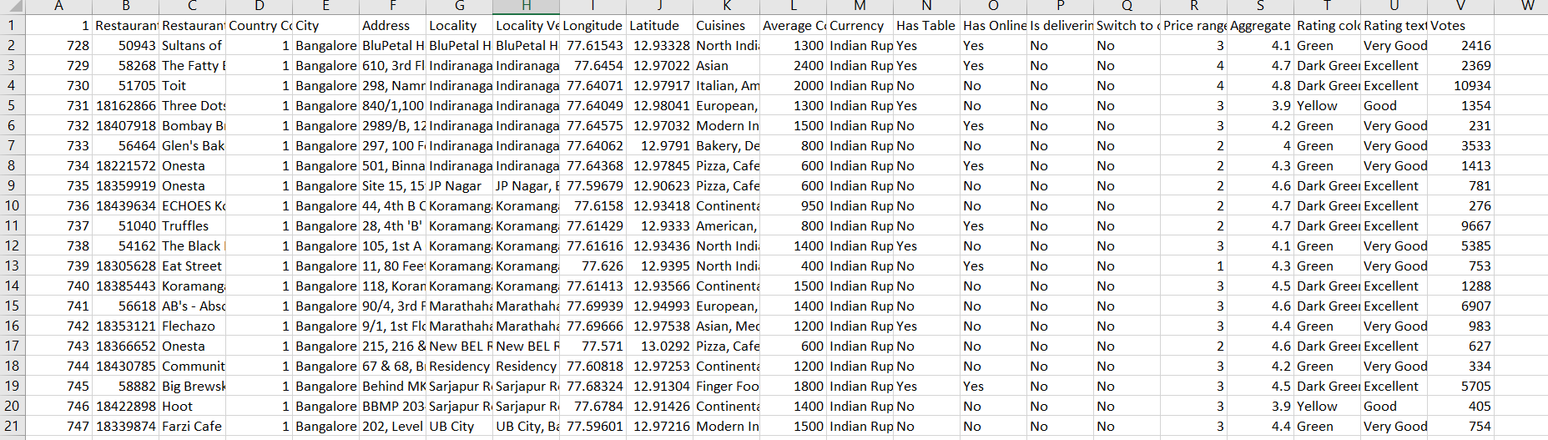
Data Processing
The data scraped from Zomato is cleaned as part of this project's data processing in order to make it ready for analysis.
By eliminating redundant entries, missing values, and unnecessary columns, the data was cleansed.
The remaining information was then processed and analyzed to find patterns and insights about the variables, such as location, estimated price range, cuisine type, and popularity of specific dishes in various places, that affect the overall ranking of restaurants in Bengaluru.

Slide 7
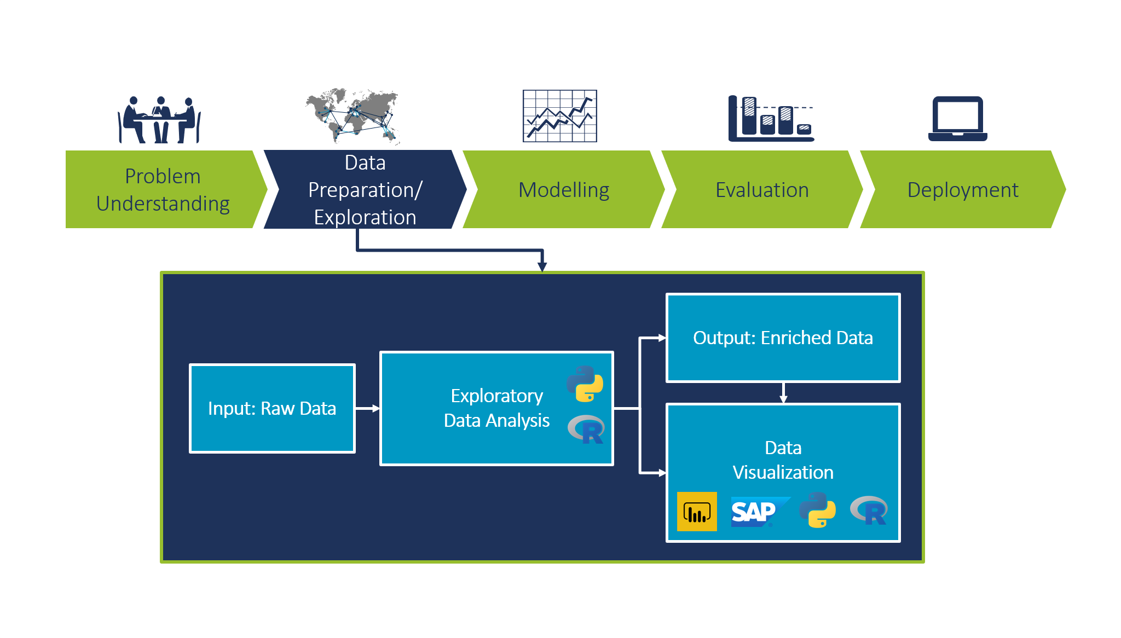
Exploratory Data Analysis
Utilizing Excel and R, I performed exploratory data analysis on restaurant data from Zomato Bangalore.
By creating visualizations like scatter plots, line graphs, tree maps, bar graphs, and box plots, I analyzed various data types, including average cost, price range, cost for two, votes, and aggregate rating.
These visualizations provided valuable insights into the distribution of data, trends over time, and relationships between different variables.

Slide 8
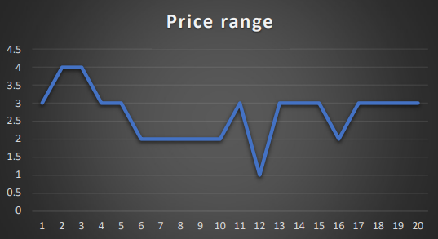
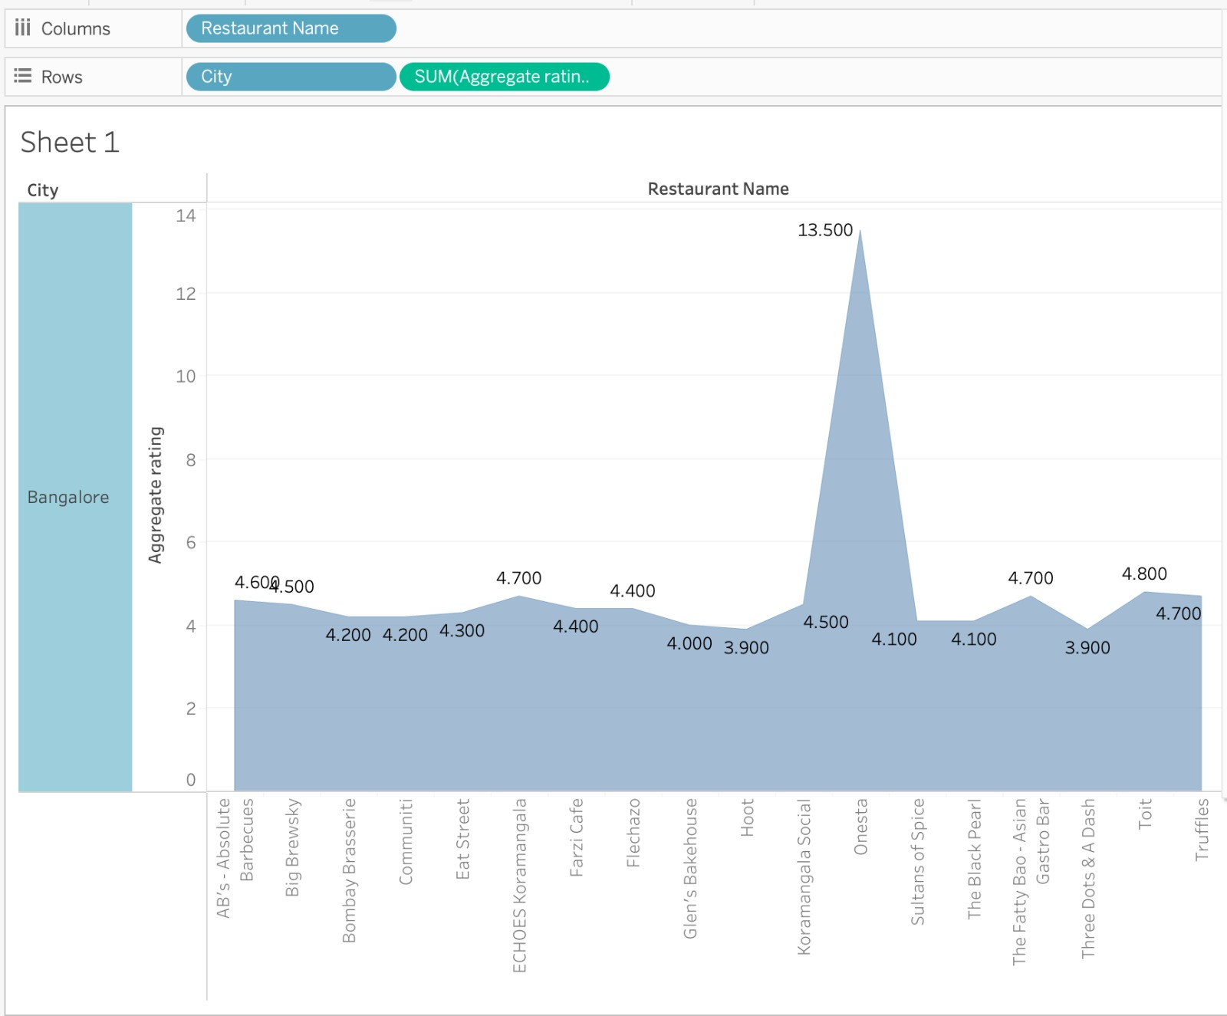
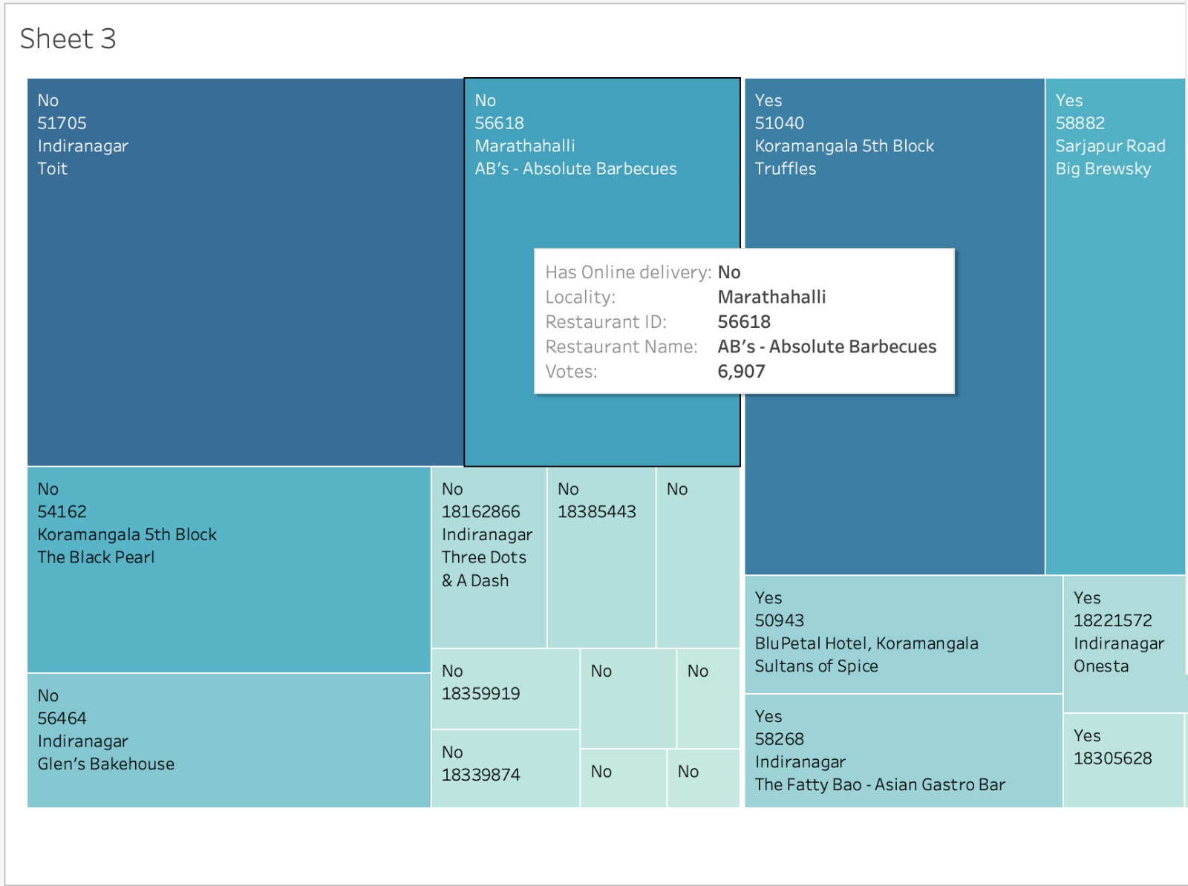
Visualization
PowerBI, Tableau, R and Excel were the applications used to visualize the intended data for this particular project.

Slide 9
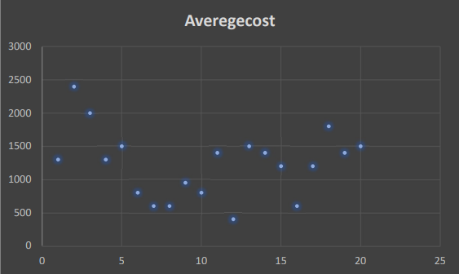
As part of this project, a variety of visualizations using Excel, PowerBI, Tableau and R were generated. These visuals were critical in gaining valuable insights into the data, such as identifying trends over time, showcasing the distribution of data, and highlighting relationships between variables.
For Example :
This scatter plot displays the relationship between two variables by representing each point on a horizontal x-axis and a vertical y-axis. When average cost is plotted, it shows the relationship between average cost and another variable, such as quantity produced or total cost. A downward-sloping line on a scatter plot indicates that as output increases, average cost decreases, while a flat or upward-sloping line suggests that average cost remains the same or increases, respectively.

Slide 10
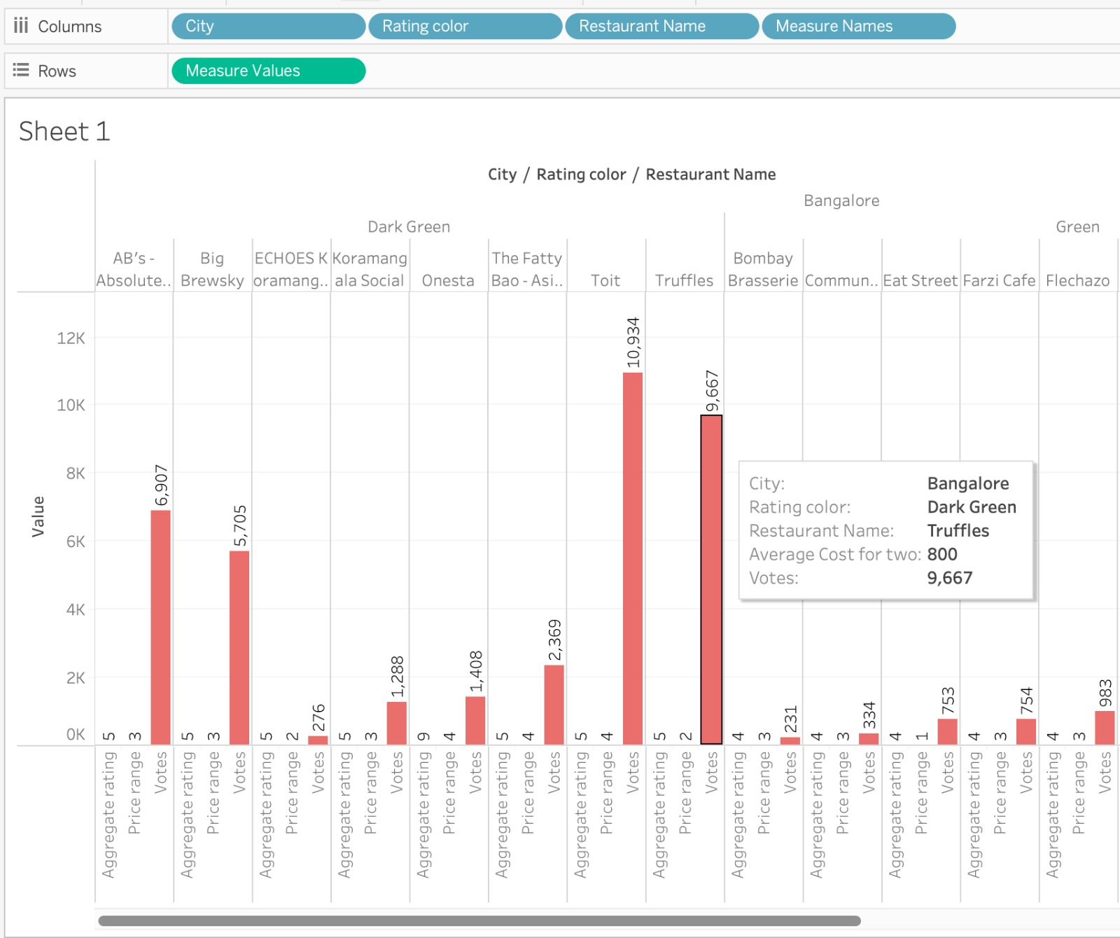
This side-by-side bar chart was chosen for its ability to show relative performance across different measures. Using different colors for each rating made the chart visually appealing and easy to read. Grouping restaurants by city allowed for comparison between different markets, and multiple metrics were displayed for each restaurant in the same chart for easy comparison. Overall, the chart effectively visualized restaurant performance and allowed for quick insights.
This Treemap chart was selected as it provides a clear visualization of each restaurant's vote share in different localities, facilitating easy comparison of their performance. The use of Votes and locality as measures and restaurant id, name, and online delivery as dimensions offered additional information. Overall, the chart was an effective way to display vote share and provide information about each restaurant.

Slide 11
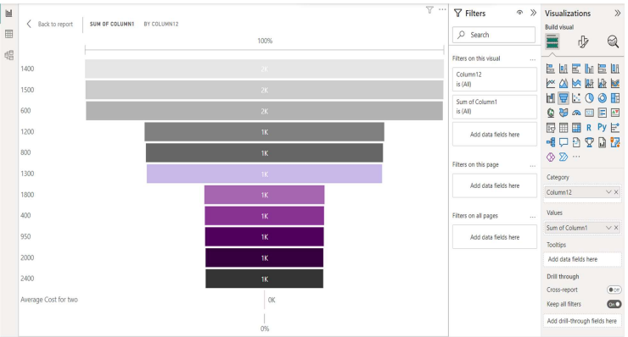
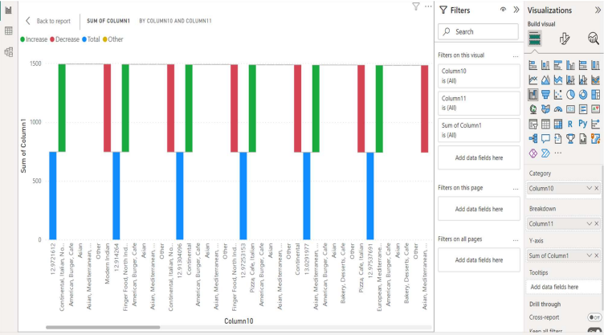
This funnel chart displays the number of votes received by each cuisine in descending order, providing a clear picture of the popularity of each cuisine. This information can be used to make informed decisions about promoting the most popular cuisines or addressing any issues affecting the popularity of less popular cuisines. Funnel charts are also useful for visualizing stages in a process or journey.
This waterfall chart displays the total number of restaurants for each cuisine in descending order. It shows how the cuisines are ranked in terms of the number of restaurants they have. This information can be used to make decisions about promoting popular cuisines or increasing the popularity of those with fewer restaurants.

Slide 12
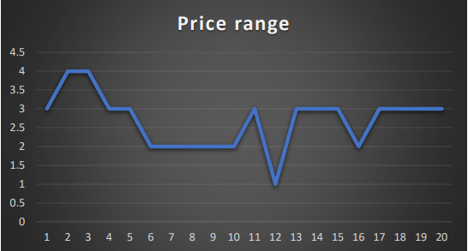
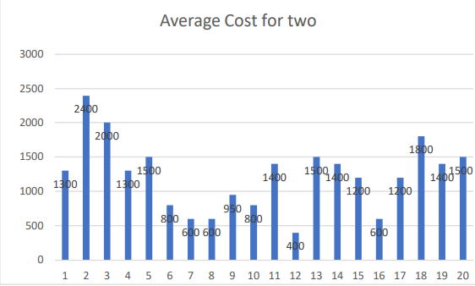
A price range graph shows the trend in the price range of a product or service over time. An upward slope indicates increasing prices, while a downward slope indicates decreasing prices. It can help identify pricing trends and compare pricing across different products or services.
The graph shows the average cost for two people to eat at different restaurants in Zomato Bangalore.
Each bar represents a restaurant or group of restaurants and its height represents the average cost.
It helps to understand the price points and compare them to other restaurants in the market.

Slide 13
Summary
This project introduces the Zomato dataset, which contains information about more than 50,000 restaurants in Bengaluru, India.
The purpose of the study is to identify the factors that affect the aggregate rating of each restaurant and to examine the demography of different locations, such as the popularity of certain cuisines and the needs of people striving to get the best cuisine of the neighborhood.
The goals of the project include analyzing the factors affecting the aggregate rating of restaurants, identifying popular types of cuisine, exploring the relationship between price and rating, identifying any patterns or clusters among restaurants, and providing insights and recommendations to new restaurants. The data is cleaned and analyzed using tools such as Tableau, Power BI, R and Excel.

Slide 14
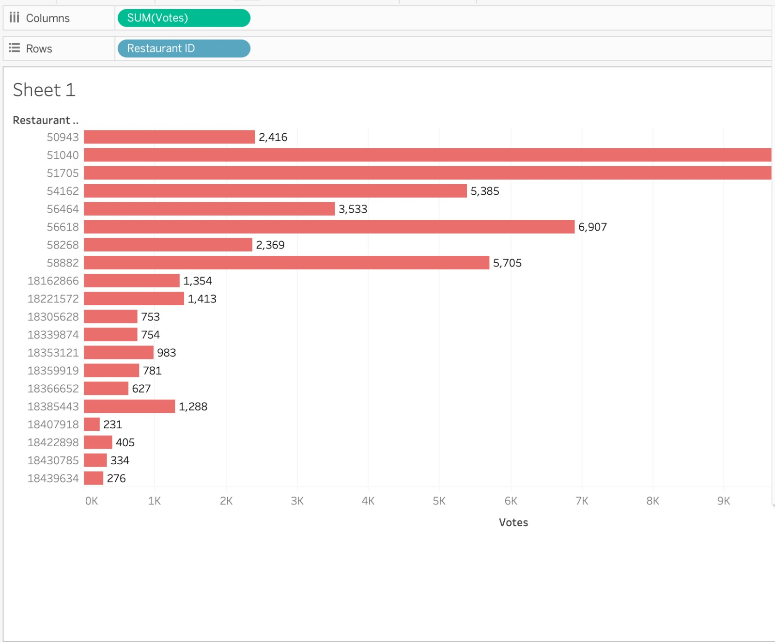
Conclusion
In conclusion, this project aims to analyze the Zomato dataset to identify factors influencing restaurant ratings and restaurant types in Bengaluru, India. The study will explore variables such as location, cuisine type, pricing, and popularity of specific dishes to provide insights and recommendations to new restaurants. Data cleaning and processing are integral parts of the project, and tools such as Tableau or Power BI and Excel will be utilized for analysis. By understanding the local demographics and food trends, this project can help new and existing restaurants in Bengaluru to make informed decisions about their location, cuisine type, and pricing strategy.

Slide 15
Sources and References
Source:
https://www.kaggle.com/datasets/himanshupoddar/zomato-bangalorerestaurants/versions/1?resource=downloa.
References:
Zomato offers a public API for developers to access and extract restaurant data from their database. This API can be used to obtain the latest data and update analysis.
Kaggle is a platform for data science competitions and has several datasets related to restaurant ratings, reviews, and pricing, including the Zomato dataset.
Google Analytics course focused on plotting and visuals.

